Slide 1



AI-RESUME
SCREENING
Guide :
Sreelekshmi K S
Assistant Professor
Dept of computer Application
Presented By :
Anusree V S
MCA S3
Roll no : 14

Slide 2

Introduction
Using AI and NLP
Automatically analyze resumes
shortlist the most suitable candidates.
It reduces manual work, improves accuracy, and speeds up recruitment

Slide 3
Abstract
The hiring process by intelligently shortlisting qualified candidates using AI and Natural Language Processing (NLP)
It reduces manual effort, improves accuracy, and speeds up recruitment by ensuring only relevant applicants move to the next stage

Slide 4
Scope
Automates resume parsing, skill extraction, and matching with job descriptions.
Supports multiple file formats and integrates with HR tools.
Uses AI models to speed up hiring and ensure fair recruitment.

Slide 5
Objective
Automate and streamline candidate selection.
Ensure fair, data-driven, and unbiased evaluation.
Improve recruitment quality and reduce hiring time

Slide 6
Feasibility study
A feasibility study is an assessment to determine if the project is practical, cost-effective, and technically achievable. This study includes the following components:
Technical feasibility
Operational feasibility
Economic feasibility

Slide 7
Technical Feasibility
Uses NLP, AI, and DB technologies.
Frameworks: Python/Django.
Integrates with ATS, supports PDF/DOCX/TXT

Slide 8
Operational Feasibility
User-friendly for HR teams.
Features: job posting, resume upload, candidate ranking.
Supports multi-user access & collaboration.
AI-driven insights.

Slide 9
Economic Feasibility
Reduces manual screening costs and errors.
Saves time and improves efficiency.
Long-term ROI benefits all company sizes.

Slide 10
Problem Definition
Manual Screening is Inefficient
Human Bias and Errors
Keyword-Based Matching is Limited
Scalability Issues
Poor Candidate Experience

Slide 11
Existing system
CONS
Time-Consuming
Not Scalable
Prone to Human
Risk of Overlooking Qualified Candidates
Lack of Automation
Not Suitable for Modern Demands
PROS
Human Judgment and Empathy
Flexibility in Evaluation
Accountability
Opportunity for interaction.
Customization of Evaluation.
Protection Against Algorithmic Bias.

Slide 12
Proposed system
PROS
Speed
Efficiency for Recruiters
Elimination of Human Bias.
Cost-Effectiveness
Improved Hiring Quality
Data-Driven Decision Making.
CONS
Limited Context Understanding.
Privacy and Security Concerns.
Continuous Maintenance Required.
Dependence on Data Quality
Compatibility Issues

Slide 13
Literature Review
Author | Year | Source | Title | Work
Dr Sandeep Tayal & Taniya Sharma | 2024 | IEEE | Resume Screening using machine learning | The paper explores how Machine Learning (ML) and Natural Language Processing (NLP) can automate and improve the resume screening process. It aims to reduce manual effort, bias, and time while enhancing the accuracy of candidate selection.
Kumar P & Sen D | 2020 | ELSEVIER | Automation in Recruitment Using Resume Parsing | Built a resume parser that uses named entity recognition (NER) to identify and structure candidate data.
Thomas J & Varghese M | 2022 | IEEE | Bias Detection in AI-Based Resume Screening Systems. | Addressed ethical issues by detecting and mitigating algorithmic bias in AI-driven recruitment tools.
Patel S & Roy K | 2023 | ACM | Scalable AI-Based Screening System for High-Volume Recruitment | Implemented a scalable resume screening system using ensemble learning to handle large datasets effectively.
Ahmed L & Banu R | 2020 | SPRINGER | Ranking Candidates Using Skill Matching Algorithms | Focused on skill-extraction algorithms to match candidates' resumes with job requirements for fair ranking.

Slide 14
System Specification
Frontend : HTML, CSS, JavaScript
Backend : Python Django
Database : MYSQL
Other Tools : Python,PyPDF2,TensorFlow&Sentence Transformers

Slide 15
modules
Admin
Recruiter
Candidate

Slide 16
Admin
Manages users and platform settings.
Accepts/rejects recruiter registrations.
Views all recruiters and candidates.

Slide 17
Recruiter
Posts job openings and manages and views applicants.
Uses AI
Auto-shortlist candidates based on resume-job match.
Schedules interviews.

Slide 18
Candidate
Allows registration and resume upload.
Applies for jobs.
Uses PyPDF2 to extract resume data

Slide 19
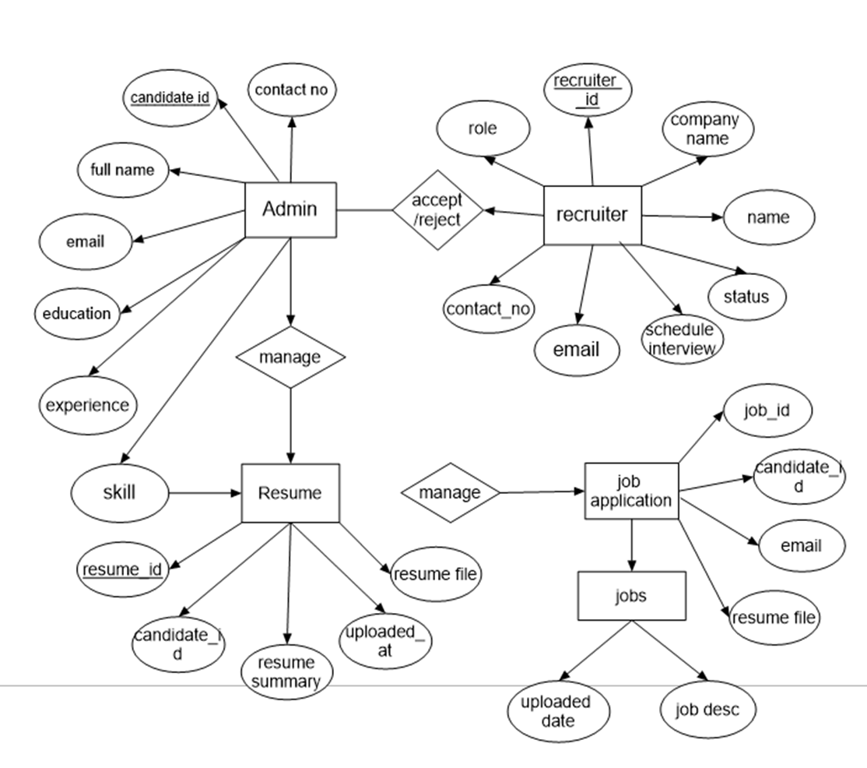
ER Diagram

Slide 20
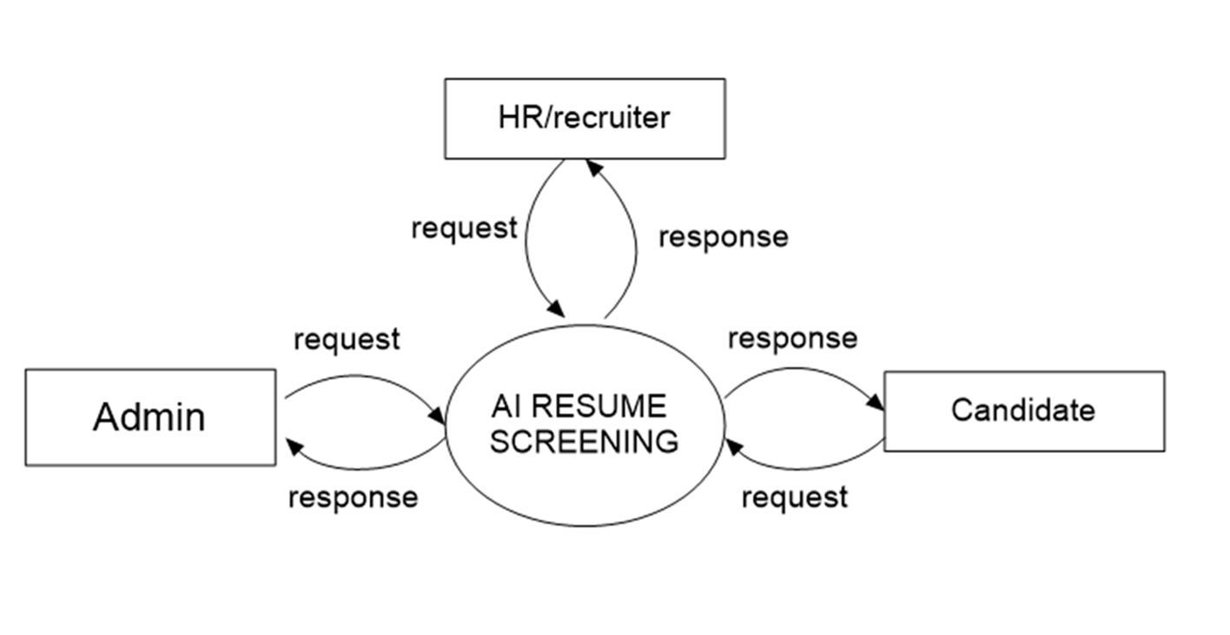
DFD FLOW DIAGRAM
Level 0

Slide 21
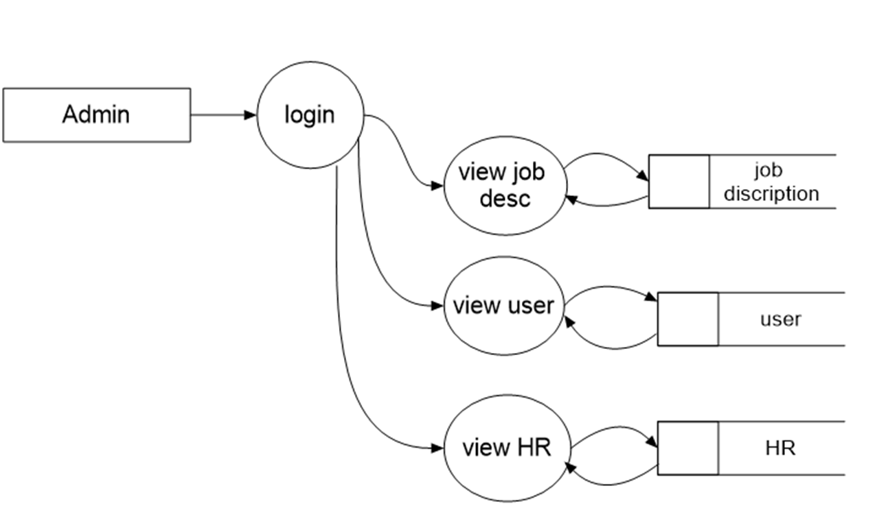
Level 1- Admin

Slide 22
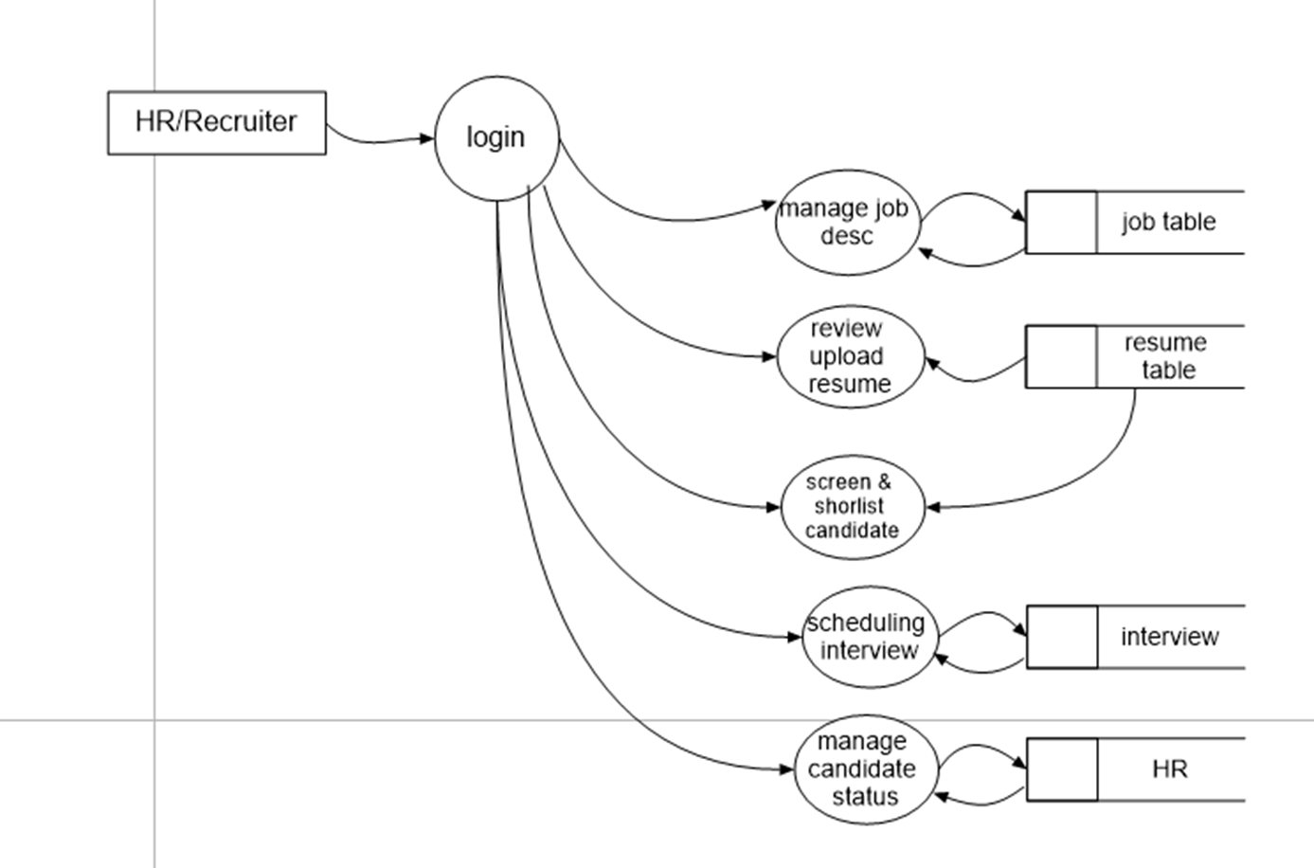
Level 1- Recruiter

Slide 23
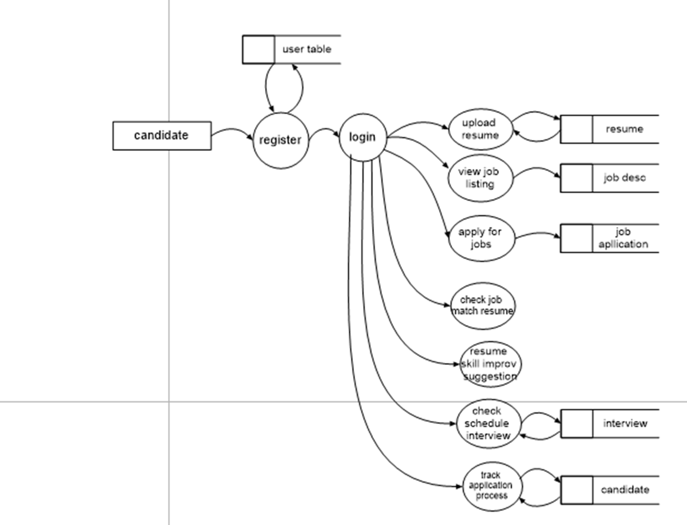
Level 1- Candidate

Slide 24
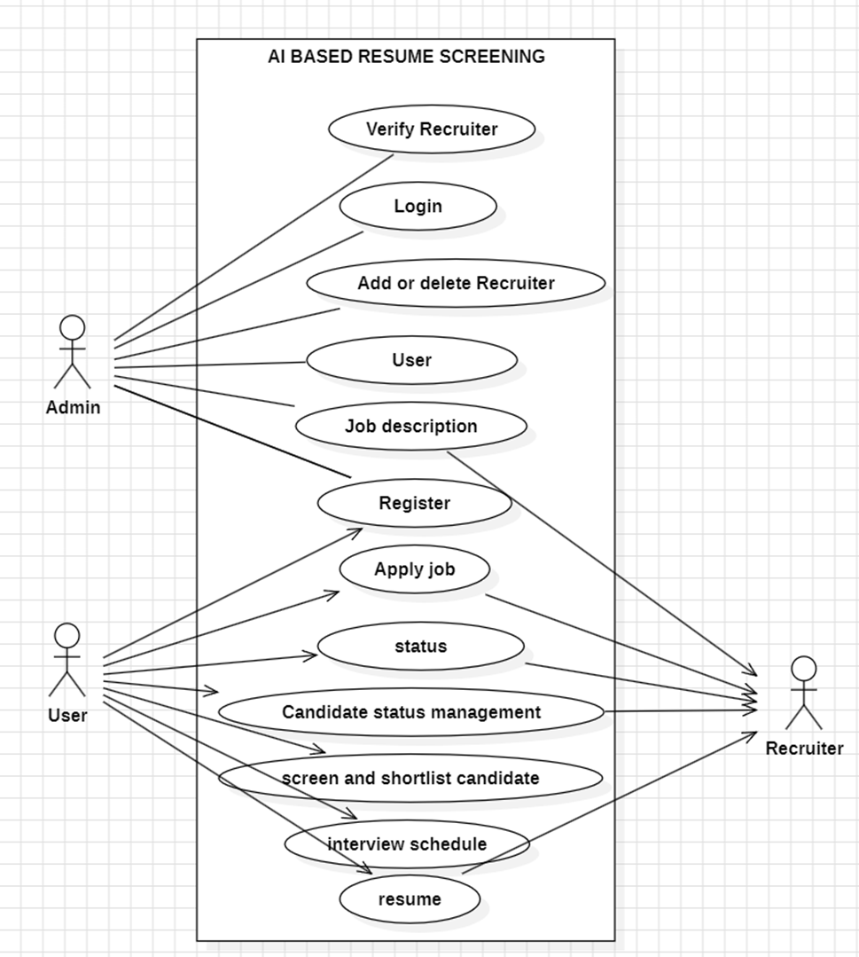
Use Case Diagram

Slide 25
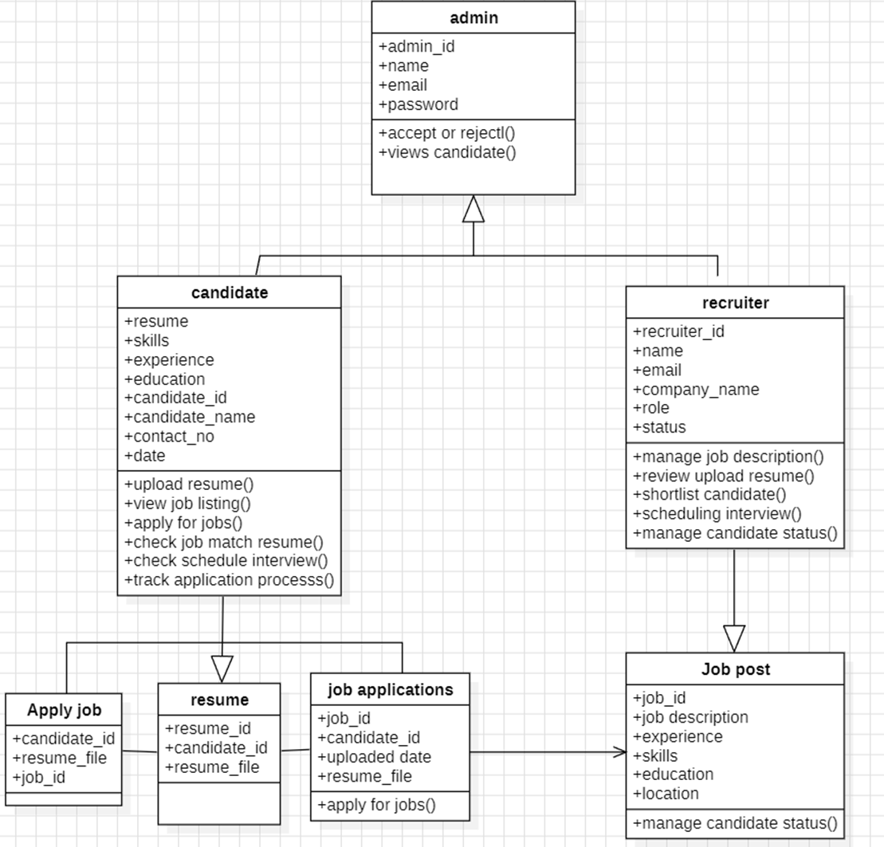
Class Diagram

Slide 26
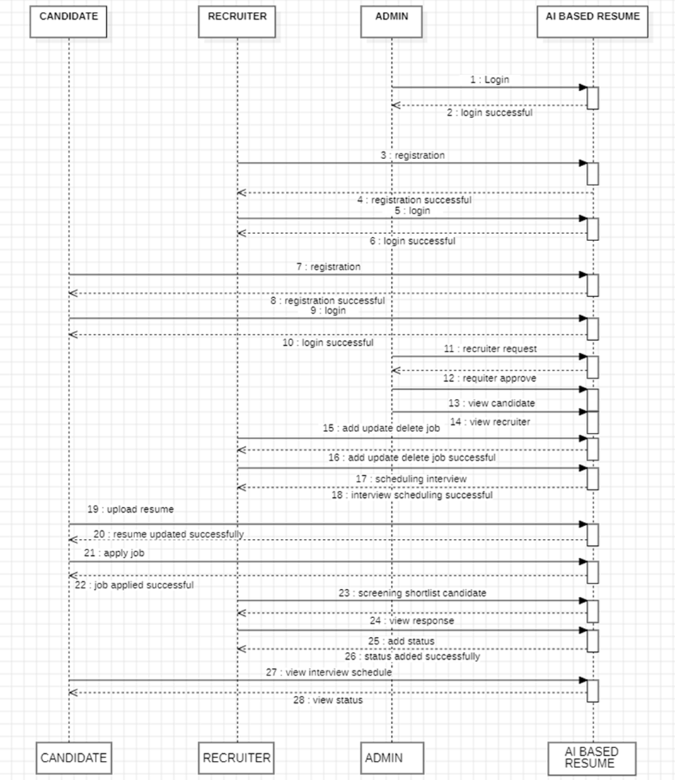
Sequence Diagram

Slide 27
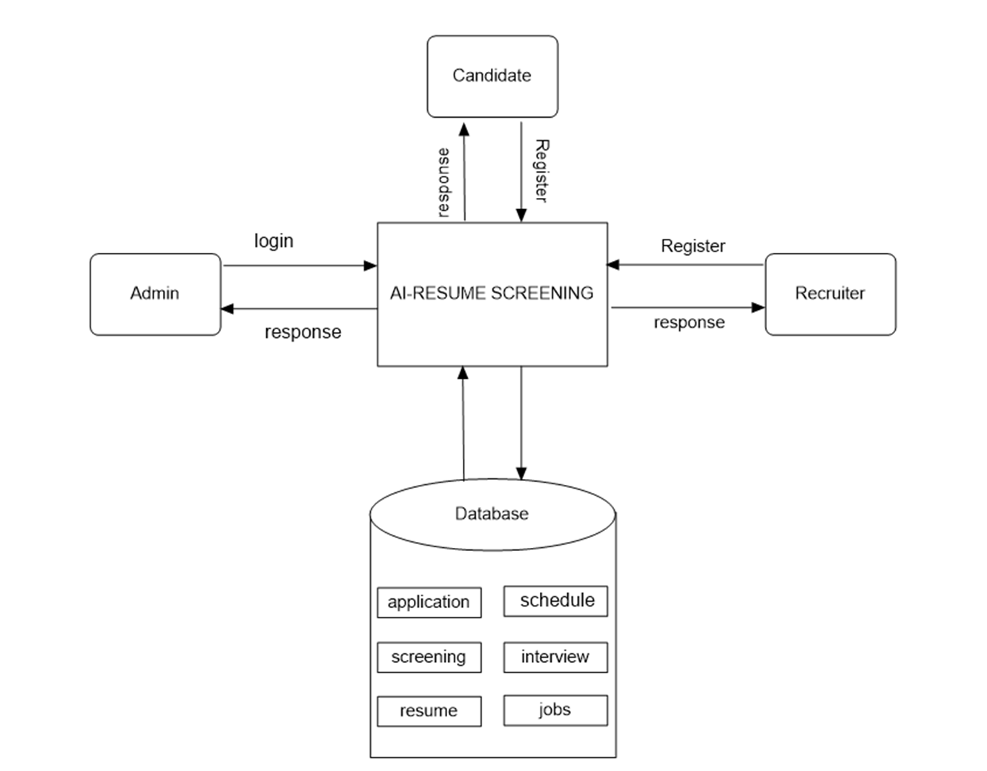
System Architecture

Slide 28
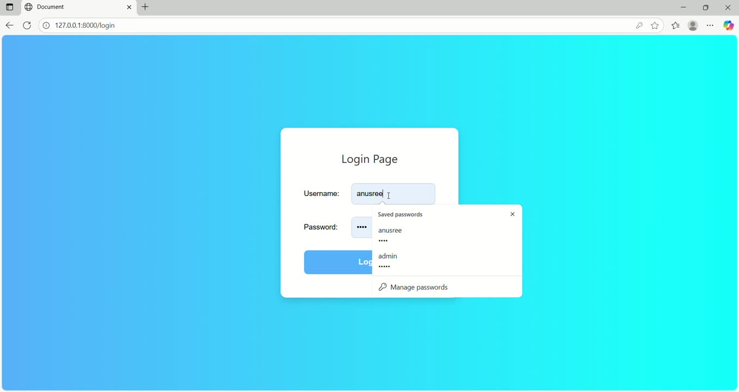
Demo video

Slide 29
90% accuracy in resume-job matching.
The average screening time is reduced from hours to a few seconds per candidate.
The platform ensures objective and consistent shortlisting, removing human bias.
AI integration
Result
Analysis

Slide 30
Conclusion
It successfully achieves its primary objective of automating and optimizing the recruitment process.
The system intelligently analyzes
shortlists resumes by semantically matching candidate skills, experience etc.

Slide 31
Future Scope
Integration with Job Portals
Interview Automation
Suggests skill improvement based on job requirements.
Recommends suitable jobs using a recommendation system.
Supports multilingual resumes with NLP processing.

Slide 32

References
Chollet, F. (2018). Deep Learning with Python. Manning Publications.
Bird, S., Klein, E., & Loper, E. (2019). Natural Language Processing with Python – Analyzing Text with the Natural Language Toolkit. O’Reilly Media.
Reimers, N. & Gurevych I. (2019). Sentence-BERT: Sentence Embeddings using Siamese BERT-Networks. Proceedings of the 2019 Conference on Empirical Methods in Natural Language Processing (EMNLP).

Slide 33

t
THANK YOU

